Slide 1
Money Cure
Team members: Izsák Attila Edmond, Dumbrăvean-Kátai Dávid, Ignát Réka, Jarto Tamara

Slide 2
The idea of the app and for what it could be used for
Our implementation is a Personal Finance Management App, called Money Cure. It was designed to be simple, yet useful for the users. The Money Cure app could be used to track your expenses, categorise them, and at end of the month see how much you’ve spend on various things. You can also make your own savings goal adjusted to your preferences, having the ability to set goals, track expenses and income.

Slide 3
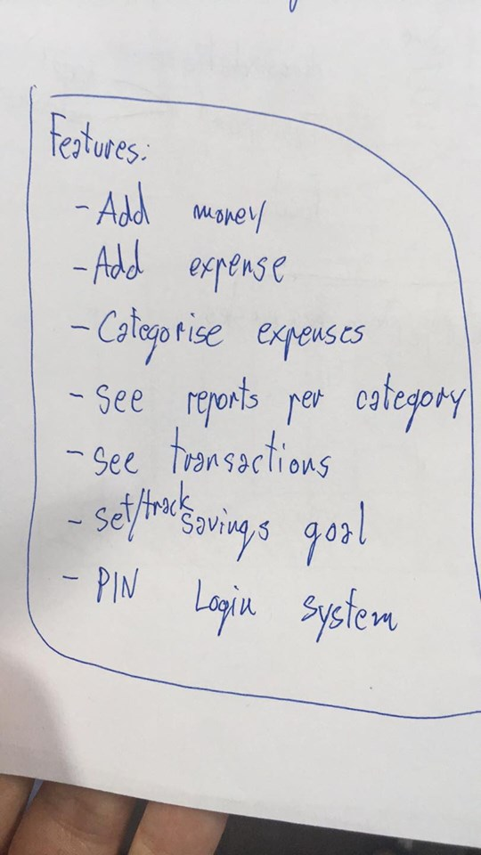
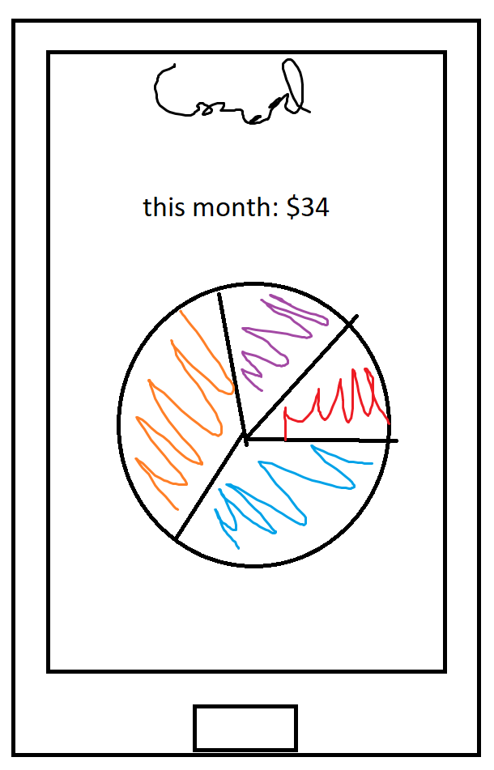
At first, we started with sharing every members ideas

Slide 4
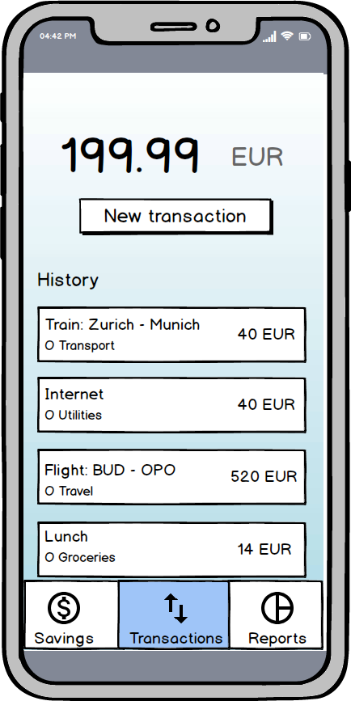
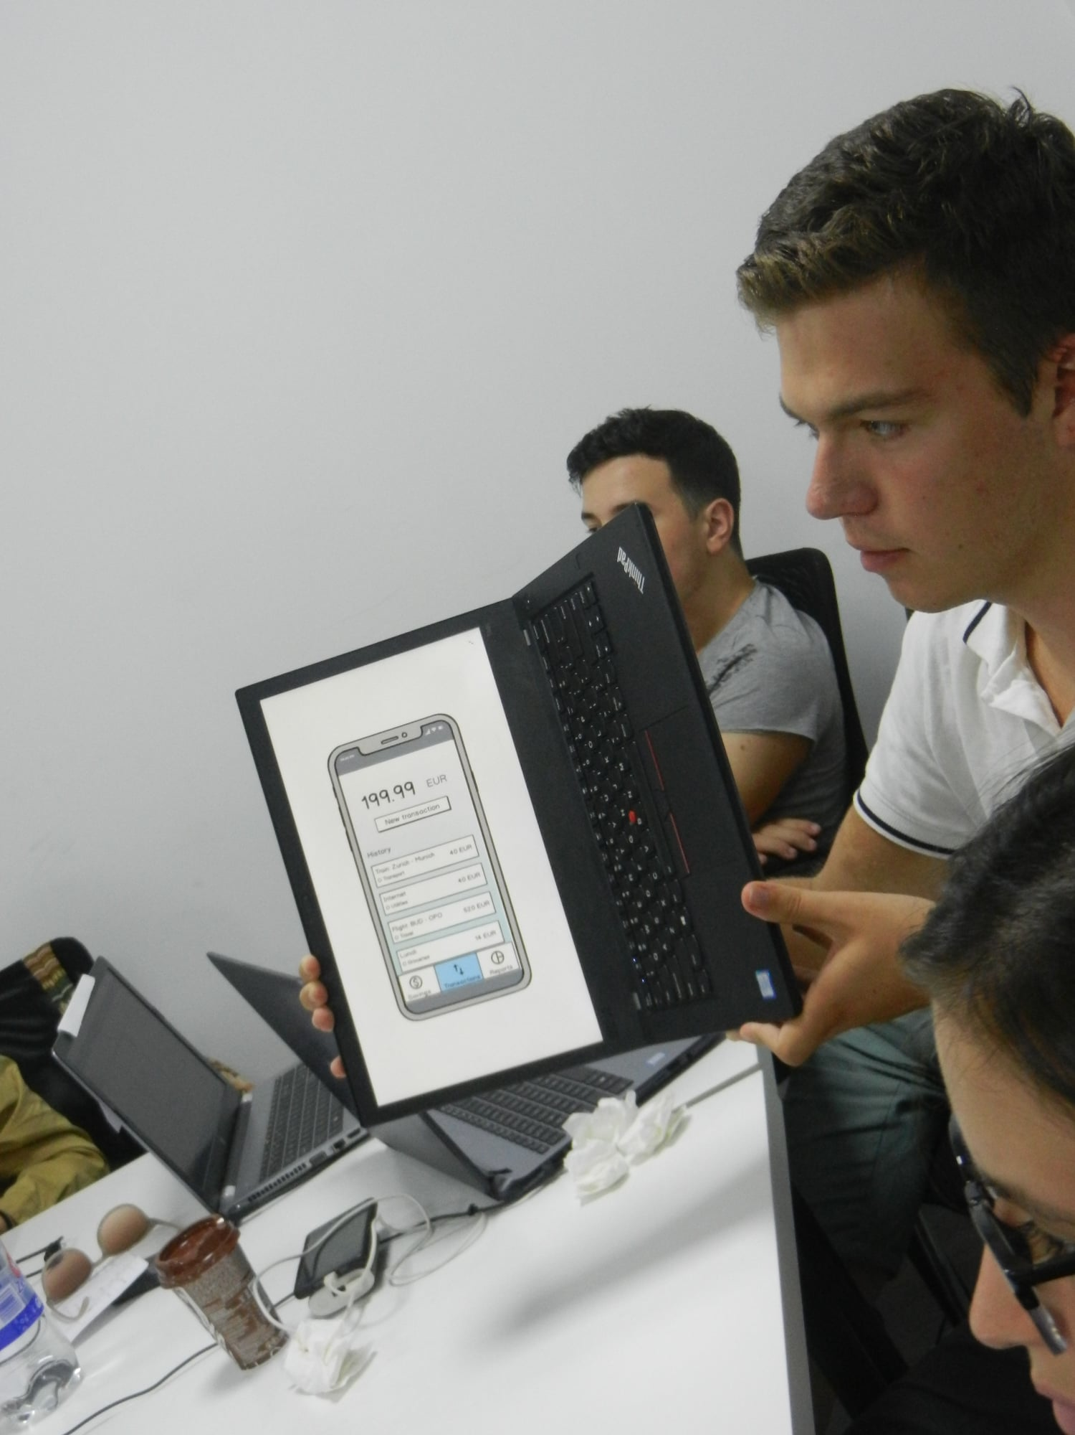
Then, things started to become more clear and we made more serious mockups

Slide 5
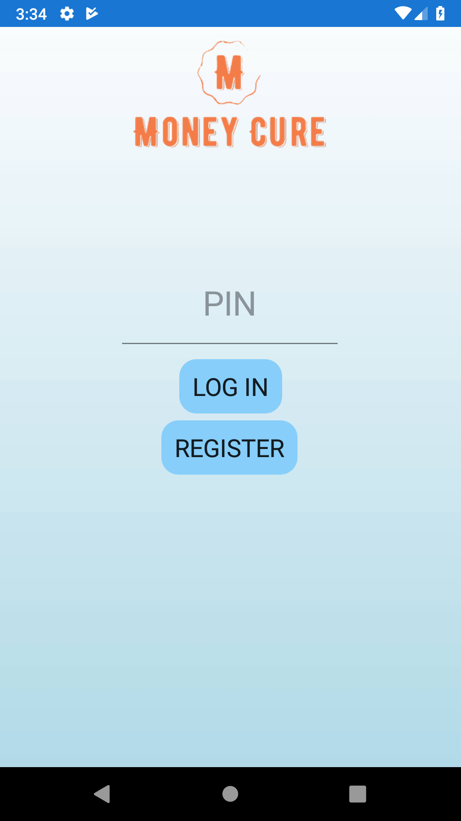
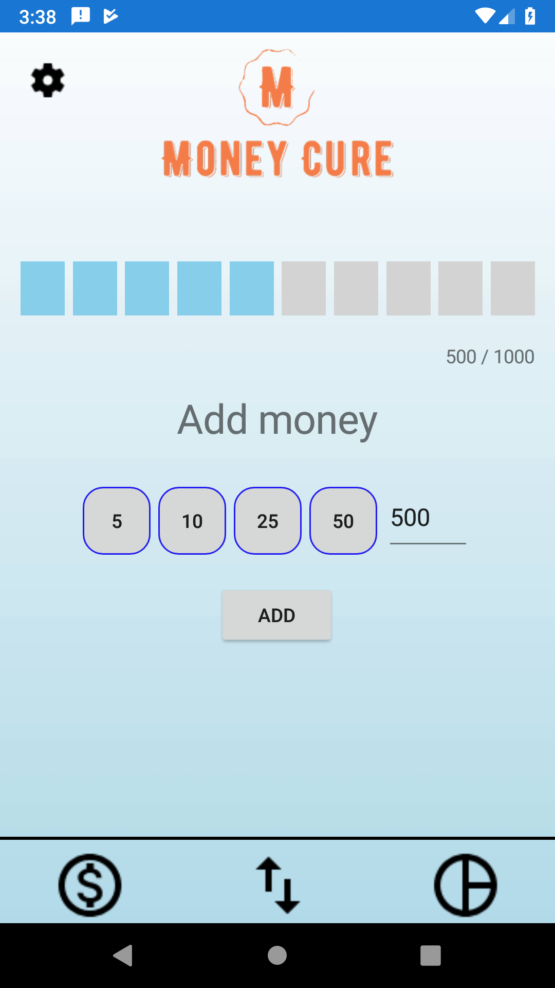
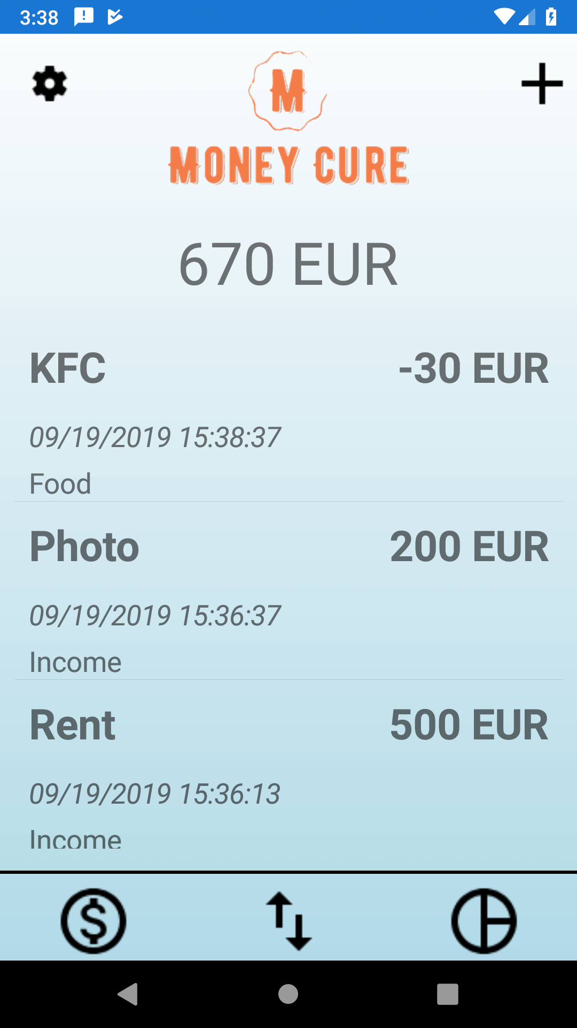
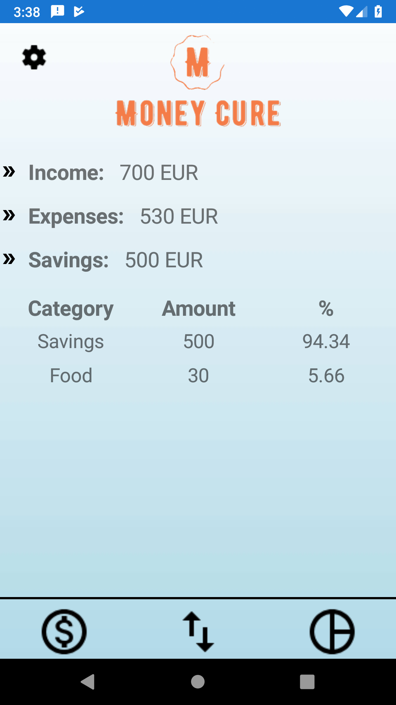
After some discussion, we have choosen a name and made our final logo
Here is the logo fitted in it’s place

Slide 6
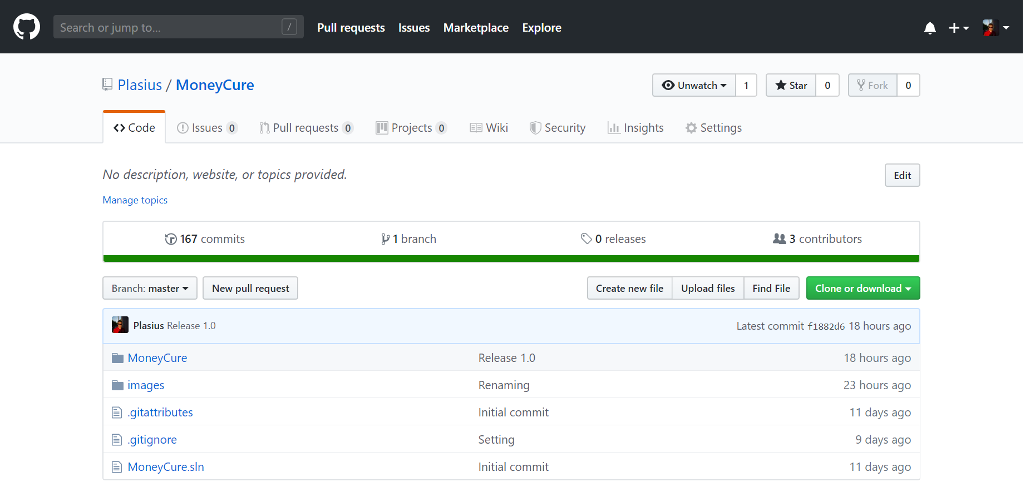
To link our ideas together, we used GitHub, a version control system.

Slide 7
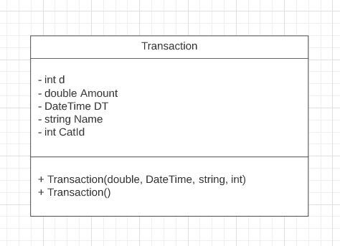
Data persistence
STORED DATA:
PINCode - string - 4-char pin code of the user
CheckingBalance - double - current user balance
SavingsGoal - double - a user-defined target to reach through saving up money
SavingsBalance - double - amount of money saved up by the user
I

Slide 8
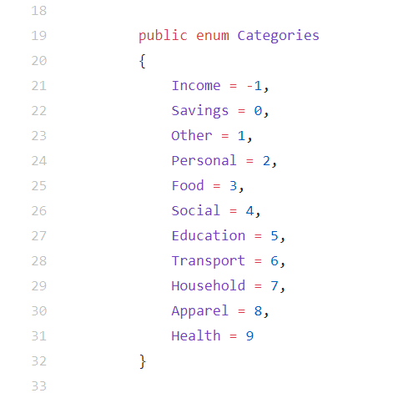
Implementation

Slide 9
What improvements can be made in the future?
We thought about:
making smarter savings accounts
making more platforms, including internet platforms and multiple user posibilities
We are open minded to make updates in de future, after getting feedback from the users and perfecting our app.

Slide 10
Simulation

Slide 11
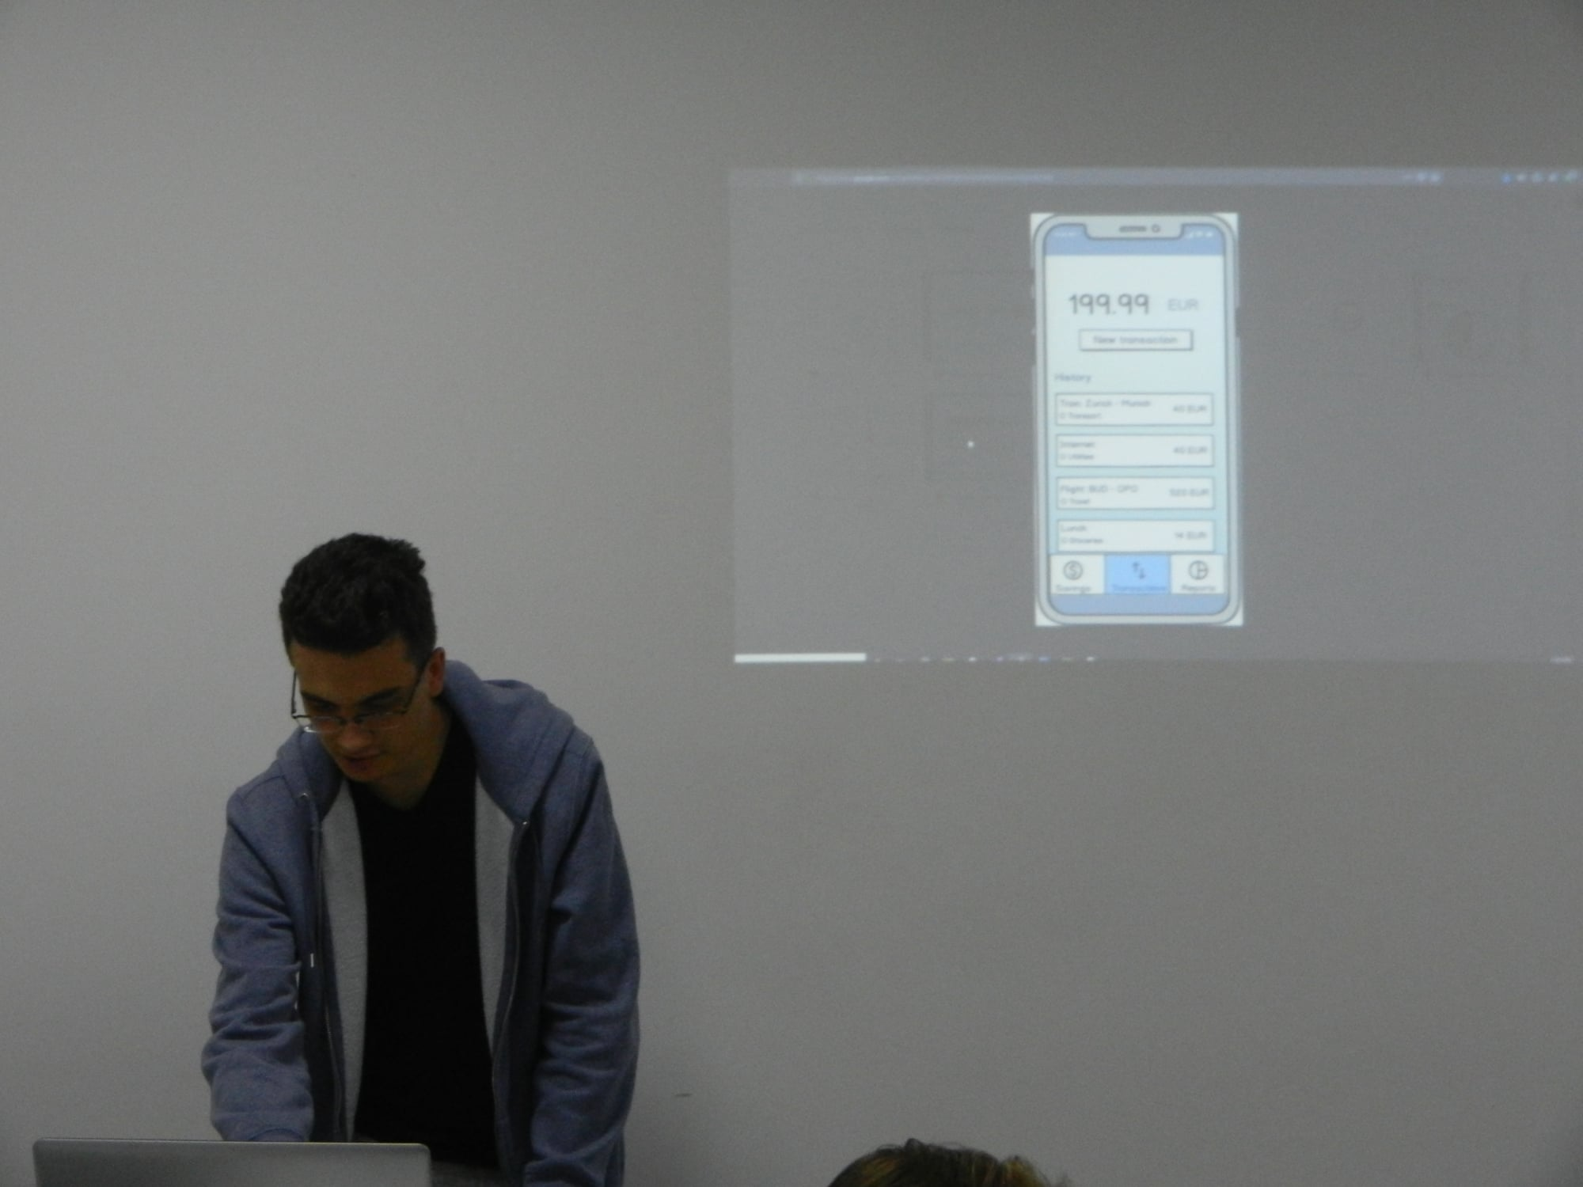
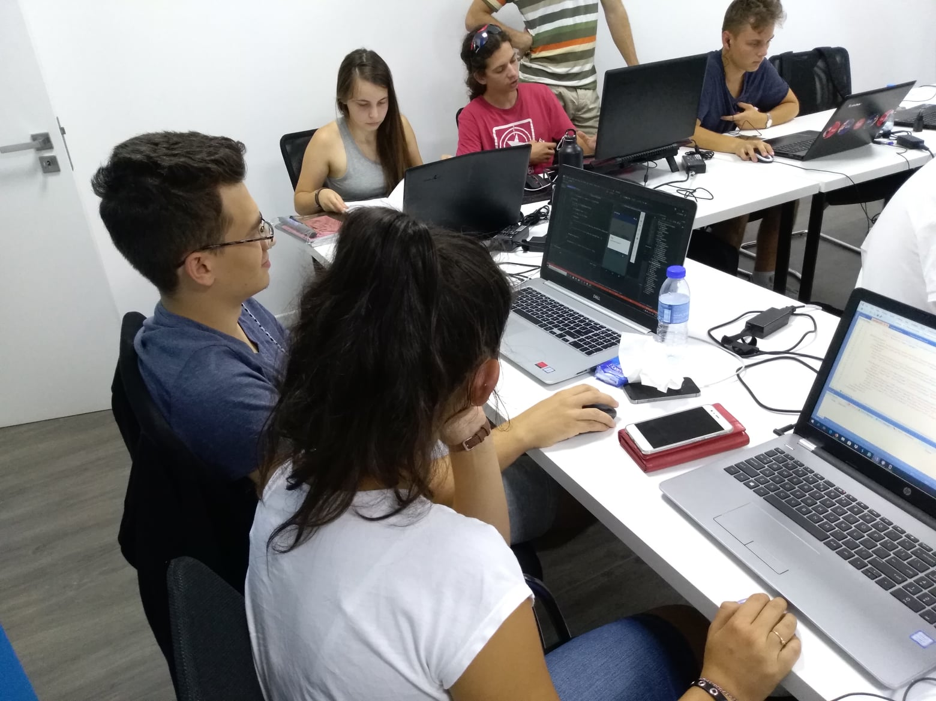
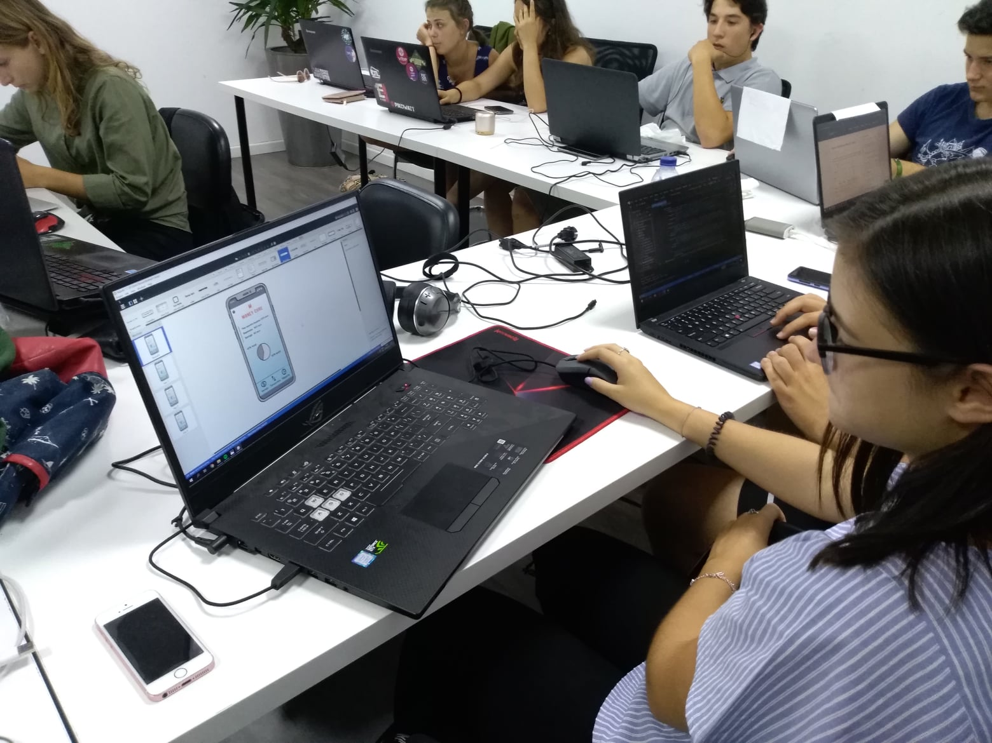
And, here we are in the progress making the app

Slide 12
Thank you for your attention!
And Download our app! ☺

